Slide 1
Introduction
to
Microsoft word 2010

Slide 2
Advance Operations in Word 2010

Slide 3
Objectives Overview
How to use quick styles in word
How to use templates in word
How to use Graphics in word
How to use auto correction in word
How to use auto formatting in word
How to insert Table of content in word
How to preview documents in word

Slide 4
Objectives Overview
How to print documents in word
How to email documents in word
How to translate in word
How to compare documents in word
How to add security to a word
How to set Watermark in word
How to perform mail merge in word

Slide 5
Apply Quick Styles
Step 1
Select a portion of text to which you want to apply some style.
Using style, you can change the selected portion of text as a heading or subheading or title of the document.
Step 2
Click the Home tab and then move your mouse pointer over the available styles in the Style Gallery.
You will see that the selected portion of text will change its style based on the selected style.
You can display more available styles by clicking the More Style button.

Slide 6
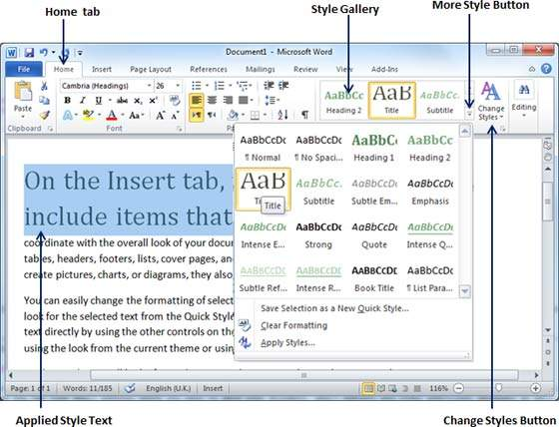
Apply Quick Styles

Slide 7
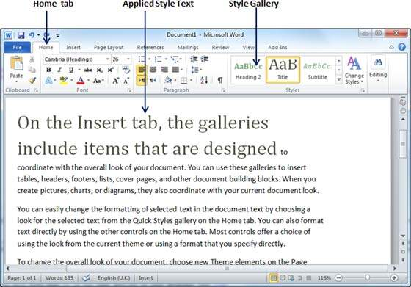
Apply Quick Styles
Step 3
Finally, to apply a selected style, click over the style and you will find that it is has been applied on the selected portion of text.

Slide 8
Change Styles
The Change Style function allows you to change the default font, colour, paragraph spacing and style set for a document.
Step 1
Click the Home tab and then click the Change Styles button; this will show you all the options that can be changed.
You can change the Style, the Font, the Colour and the Spacing of the paragraph.

Slide 9
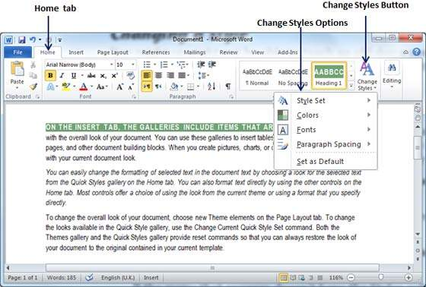
Change Styles

Slide 10
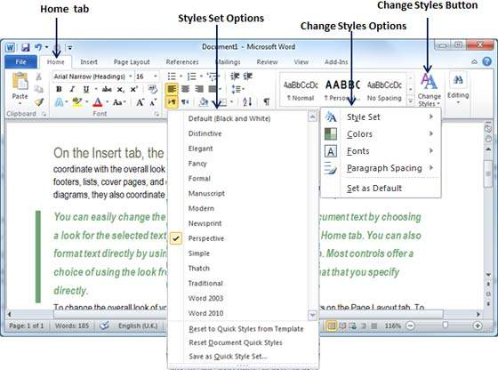
Change Styles
Step 2
If the style set needs to be changed,
click the Style Set option; this will display a submenu to select any of the available style set.
When you move your mouse over the different style sets, you will get real time text preview to give an idea about the final result.

Slide 11
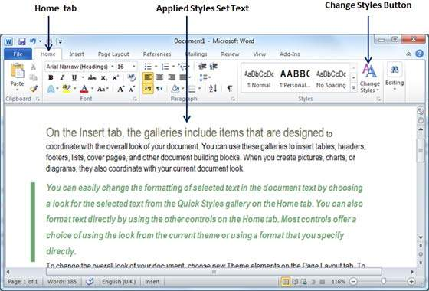
Change Styles
Step 3
To apply a selected style set,
Click over the style set and you will find that it is has been applied on your document

Slide 12
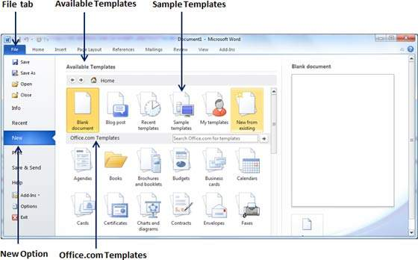
Using Existing Template
Step 1
To start a new document, click the File tab.
Click the New option; this will display the Available Templates.

Slide 13
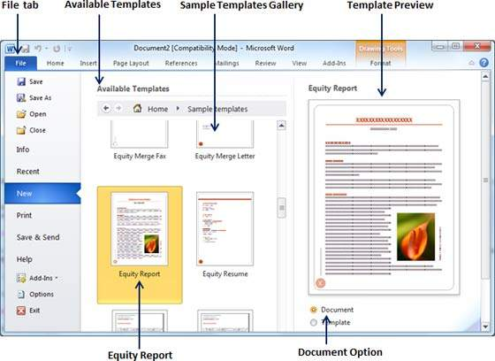
Using Existing Template
Step 2
Microsoft Word provides a list of templates arranged under Sample Templates or you can download hundreds of templates from office.com which are arranged in different categories.
We will use Sample Templates for our document.

Slide 14
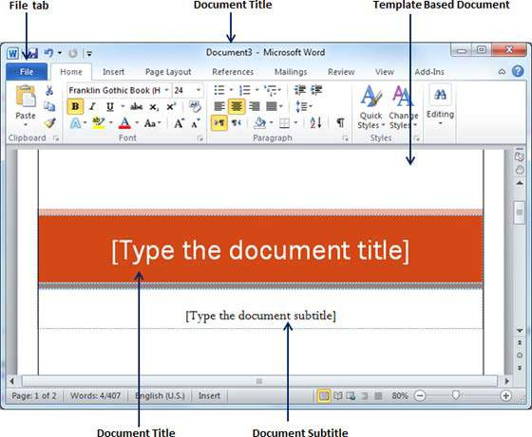
Using Existing Template
Step 3
Select Equity Report template for our report requirement.
Select the Document Option available in the third column.

Slide 15
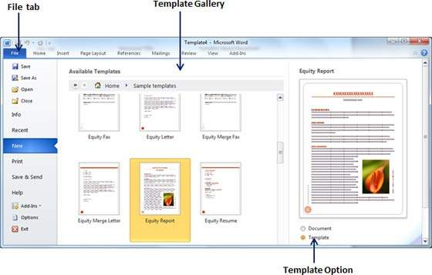
Create New Template
Step 1
To create a new template using an existing template, click the File tab and then click the New option.
A Microsoft Word template file has an extension of .dotx.

Slide 16
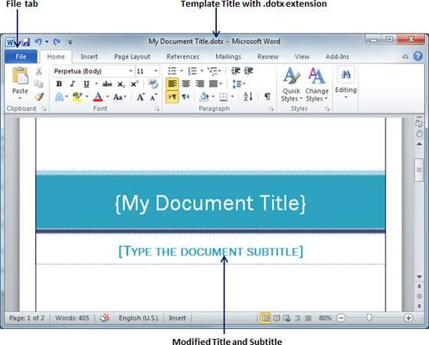
Create New Template
Step 2
You can now modify an open template as per your requirements and once you are done,
you can save this template with a .dotx extension which is a standard extension for Microsoft Word Templates..

Slide 17
Adding Picture in Document
Step 1
Click on your document where you want to add a picture.
Step 2
Click the Insert tab
click the Picture option available in illustrations group, which will display the Insert Picture dialog box.

Slide 18
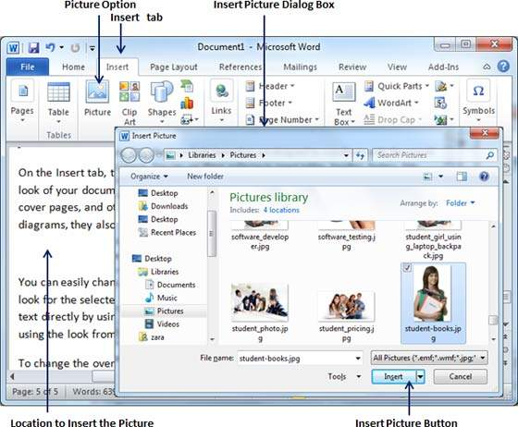
Adding Picture in Document

Slide 19
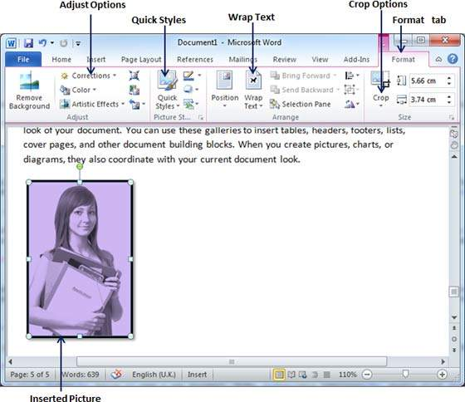
Adding Picture in Document
Step 3
You can select a required picture using the Insert Picture dialog box.
When you will click the Insert button, selected picture will be inserted in your document.

Slide 20
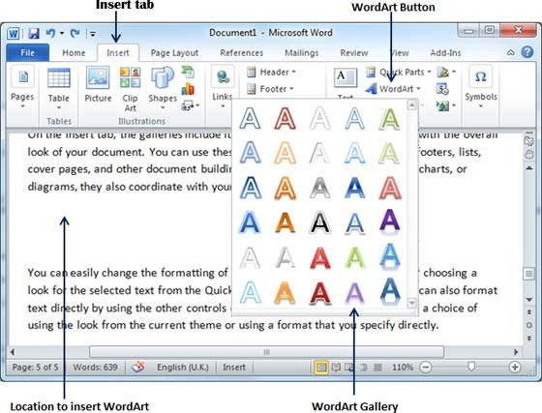
Adding WordArt in Document
Step 1
Click in your document where you want to add WordArt.
Step 2
Click the Insert tab
Click the WordArt option available in the Text group; this will display a gallery of WordArt.

Slide 21
Adding WordArt in Document
Step 3
You can select any of the WordArt style from the displayed gallery by clicking on it.
Now you can modify the inserted text as per your requirement and you can make it further beautiful by using different options available.
Double-click your inserted WordArt and Word will give you numerous options available from the Format tab to format your image.
Most frequently used options are Shape Styles and WordArt Styles.

Slide 22
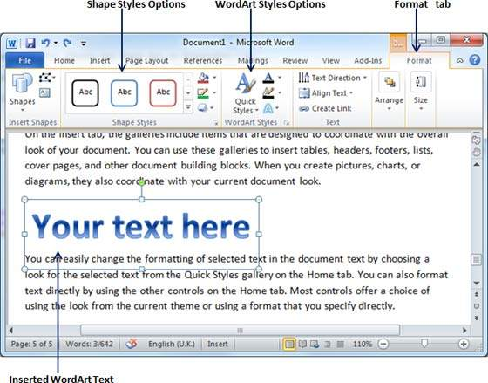
Adding WordArt in Document

Slide 23
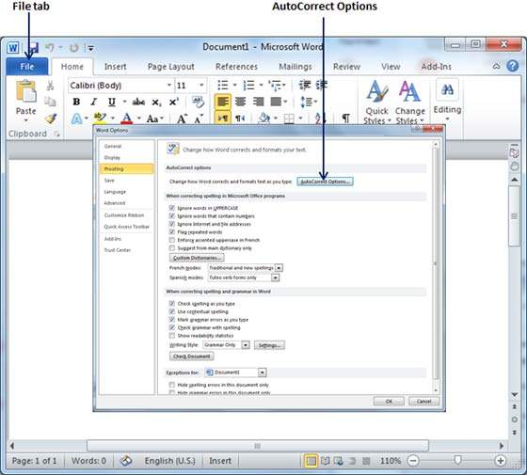
Setting AutoCorrect
Step 1
Click the File tab, and then Click Options,
Click the Proofing option available in the left most column, it will display the Word Options dialog box.

Slide 24
Setting AutoCorrect
Step 2
Click the AutoCorrect Options button which will display the AutoCorrect dialog box.
Click the AutoCorrect tab.
Now you have to make sure all the options are enabled, especially the Replace Text as you type option.

Slide 25
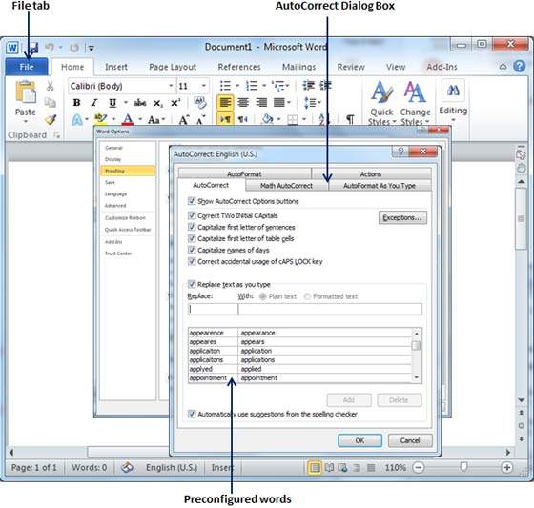
Setting AutoCorrect
Step 2

Slide 26
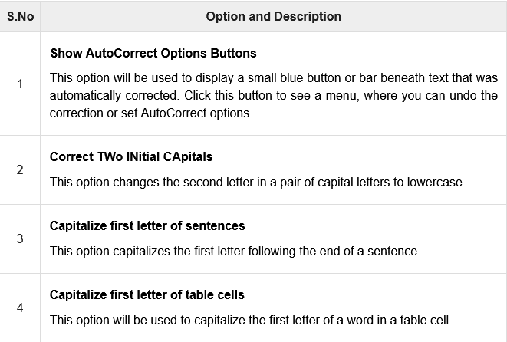
Setting AutoCorrect
Step 3
Select from among the following options, depending on your preferences.

Slide 27
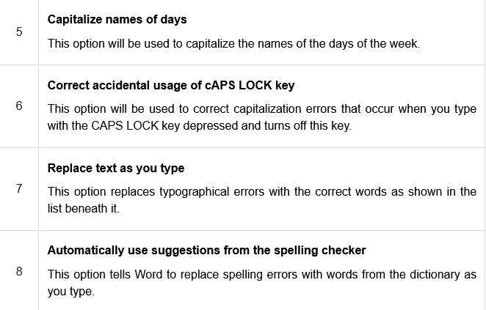
Setting AutoCorrect
Step 3
Select from among the following options, depending on your preferences.

Slide 28
Setting AutoCorrect
Step 3
Although Word comes preconfigured with hundreds of AutoCorrect entries, you can also manually add entries using the following dialog box and use the Replace and With text boxes to add more entries.
I added an entry for Markiting which should be replaced with Marketing.

Slide 29
Setting AutoCorrect
Step 4
Click OK to close the AutoCorrect Options dialog box
Click OK to close the Word Options dialog box.
Now try to type Markiting and as soon as you type this word, Microsoft Word autocorrects it with the correct word Marketing word.

Slide 30
Setting AutoFormat
Step 1
Click the File tab, and then Click Options,
Click the Proofing option available in the left most column, it will display the Word Options dialog box.

Slide 31
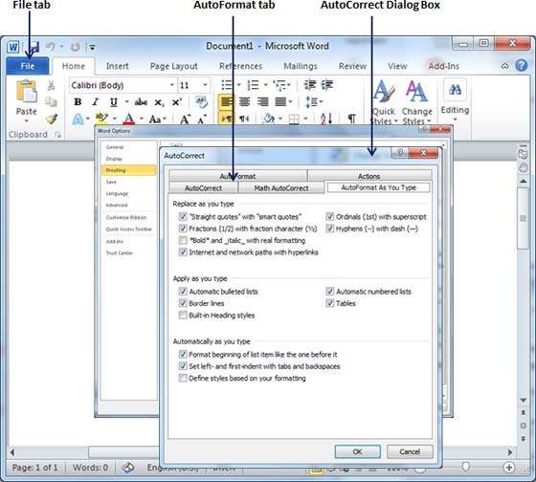
Setting AutoFormat
Step 2
Click the AutoCorrect Options button; this will display the AutoCorrect dialog box.
click the AutoFormat As You Type tab to determine what items Word will automatically format for you as you type.

Slide 32
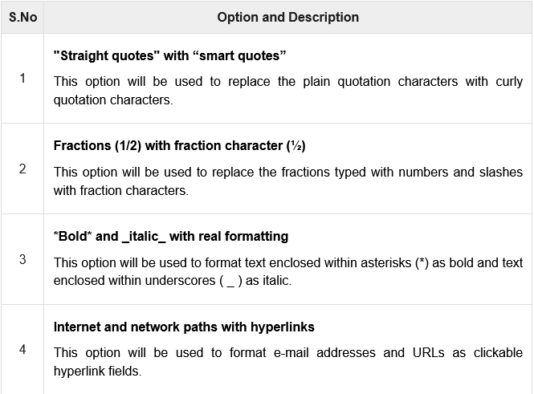
Setting AutoFormat
Step 3
Select from among the following options, depending on your preferences.

Slide 33
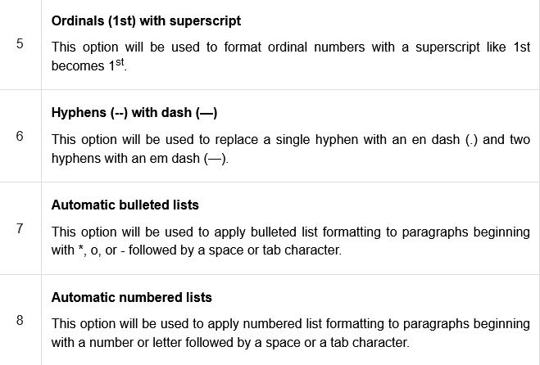
Setting AutoFormat
Step 3
Select from among the following options, depending on your preferences.

Slide 34
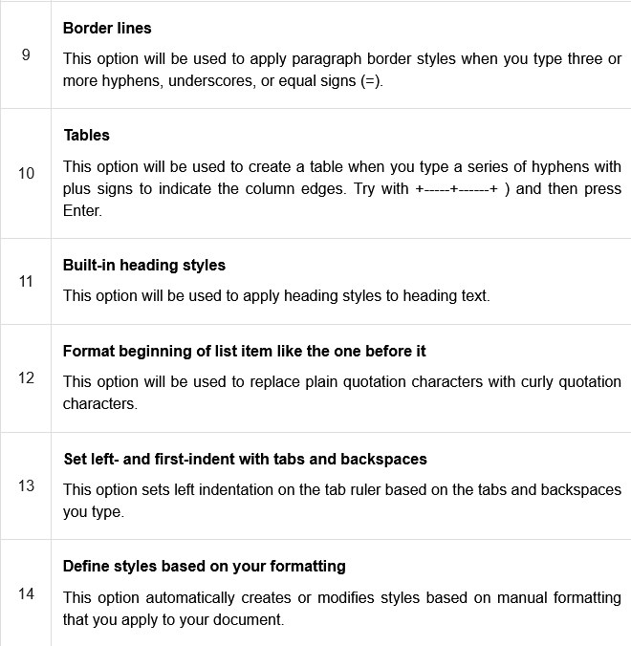
Setting AutoFormat
Step 3
Select from among the following options, depending on your preferences.

Slide 35
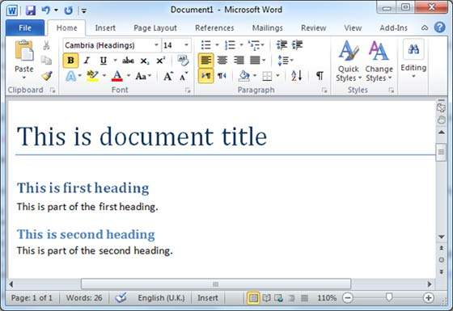
Create Table of Contents
A table of contents (or TOC) is a list of headings in the order in which they appear in the document.
Step 1
Consider a document having different levels of headings..

Slide 36
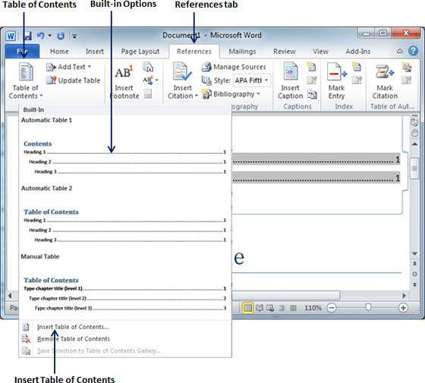
Create Table of Contents
Step 2
You can insert a table of content anywhere in the document, but the best place is always at the beginning of the document.
Bring your insertion point at the beginning of the document and then click the References tab followed by the Table of Content button;

Slide 37
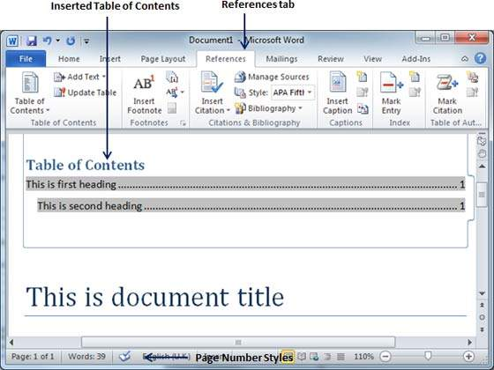
Create Table of Contents
Step 3
Select any of the displayed options by simply clicking on it. A table of content will be inserted at the selected location.

Slide 38
Create Table of Contents
Step 4
Select any of the displayed options by simply clicking on it. A table of content will be inserted at the selected location.
If you click on the Insert Table of Content option available in the option menu, then it will show you a dialog box where you can select the number of levels you want to have in your table of content.
You can turn ON or turn OFF the Show Page Numbers option. Once done, click the OK button to apply the options.

Slide 39
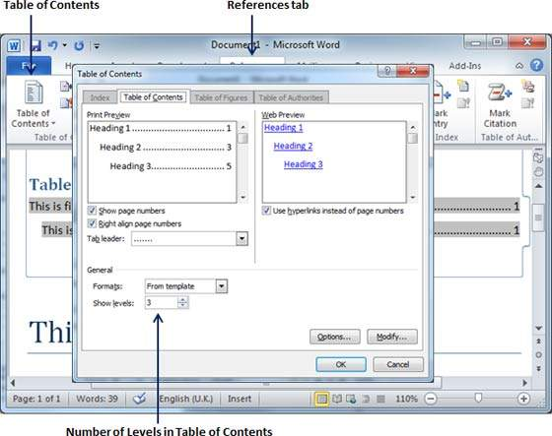
Create Table of Contents
Step 4

Slide 40
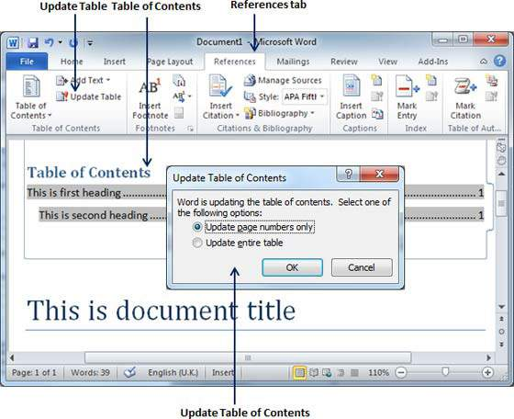
Update Table of Contents
Step 1
Consider you already have a table of content as shown below.
Click the References tab followed by the Update Table button; this will display the Update Table of Contents dialog box with two options.

Slide 41
Update Table of Contents
Step 2
If you want to update just the page numbers then select the first option Update page numbers only available in the dialog box
Select the second option Update entire table and you will find your table of content updated with all the latest changes.

Slide 42
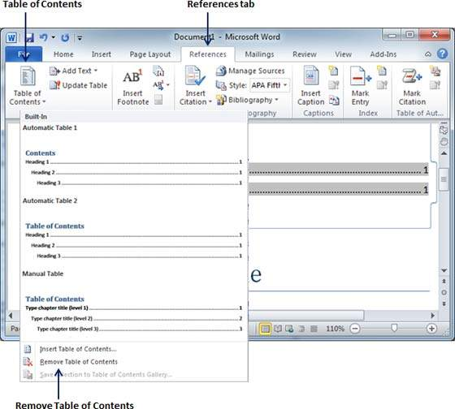
Delete Table of Contents
Step 1
Click the References tab and next Table of Contents button which will display a list of Table of Contents options along with Remove Table of Contents option available at the bottom.

Slide 43
Preview Documents
Step 1
Open the document the preview of which you want to see.

Slide 44
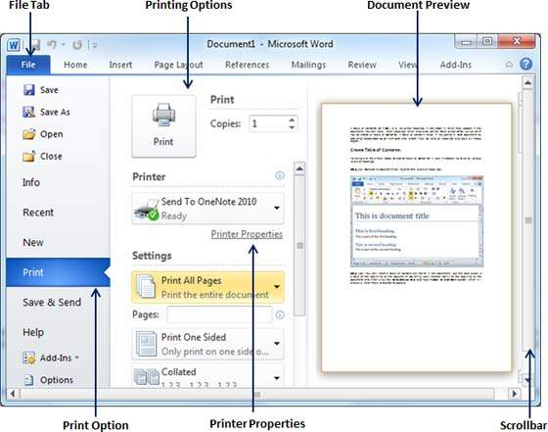
Preview Documents
Step 2
Click the File tab followed by the Print option; this will display a preview of the document in the right column.

Slide 45
Printing Documents
Step 1
Click the File tab followed by the Print option; this will display a preview of the document in the right column.

Slide 46
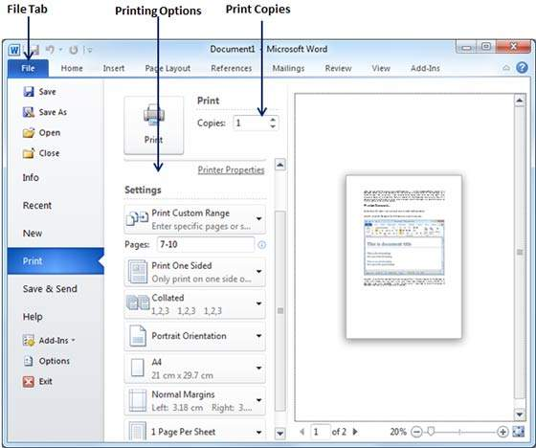
Printing Documents
Step 2
You can set various other printing options available. Select from among the following options, depending on your preferences.

Slide 47
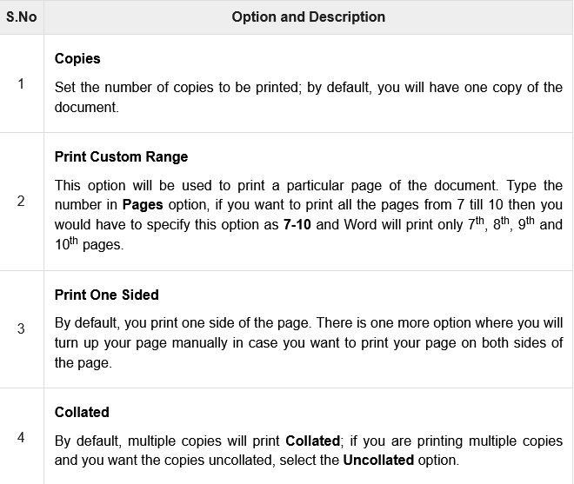
Printing Documents
Step 2

Slide 48
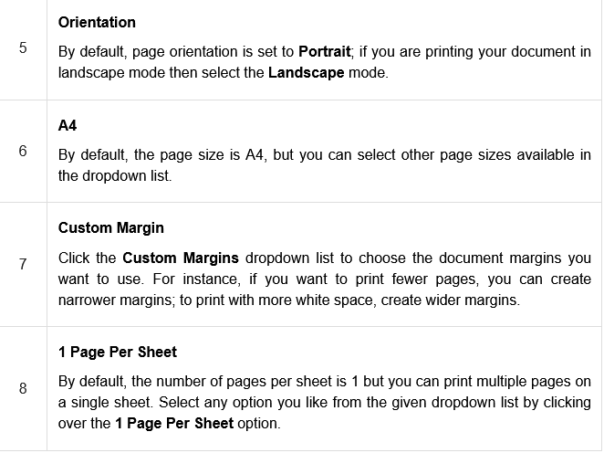
Printing Documents
Step 2

Slide 49
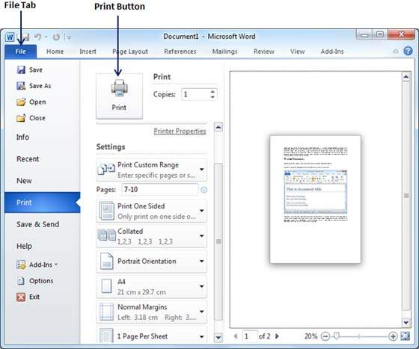
Printing Documents
Step 3
Once you are done with your setting, click on the Print button which will send your document to the printer for final printing.

Slide 50
Mailing Documents
Step 1
Open the document you want to send using e-mail as an attachment.
Step 2
Click the File tab.
click the Save & Send option from the left most column; this will display a number of options to Save & Send,
You will have to select the Send using Email option available in the middle column.

Slide 51
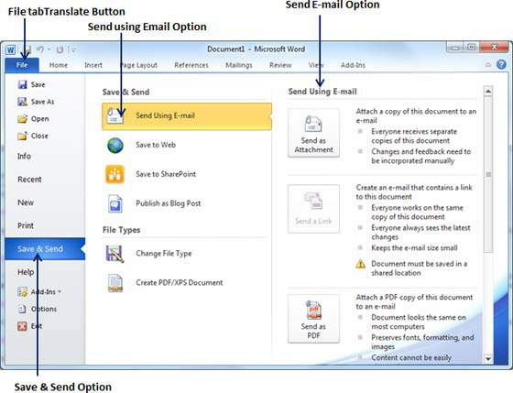
Mailing Documents

Slide 52
Mailing Documents
Step 3
The third column will have various options to send email which allows you to send your document as an attachment in DOC format.
You can send your Word document in a PDF format.

Slide 53
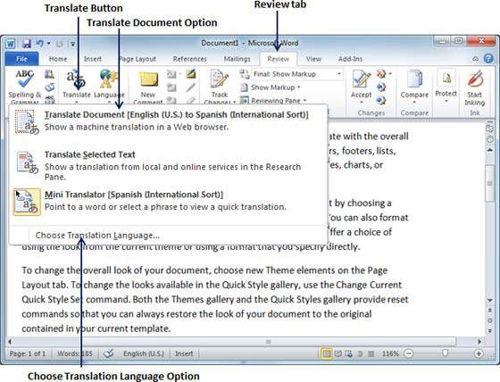
Translate Document Using Microsoft Translator
Step 1
Click the Review tab and then click the Translate button; this will display different options to be selected.

Slide 54
Translate Document Using Microsoft Translator
Step 2
Select the Choose Translation Language option simply by clicking over it.
This will display a Translation Language Options dialog box asking for selecting from and to languages.
Here From is the source document's language and To is the target document’s language.

Slide 55
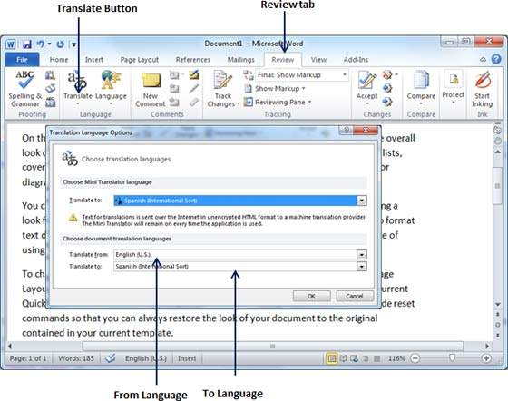
Translate Document Using Microsoft Translator
Step 2

Slide 56
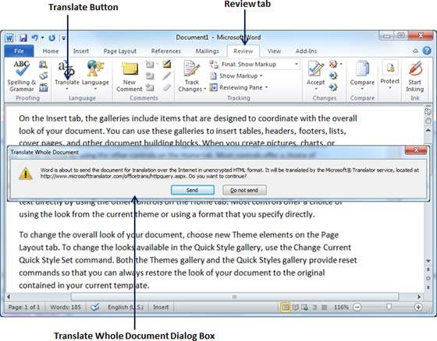
Translate Document Using Microsoft Translator
Step 3
After selecting From Language and To Language, click OK.
Now again go to Review tab and then click Translate button which will display different options to be selected.

Slide 57
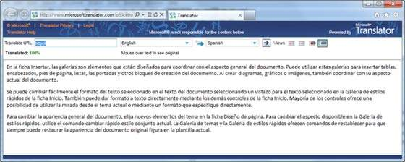
Translate Document Using Microsoft Translator
Step 4
To translate your document, you can click the Send button.
This will send your document over the internet to be translated and you will have your document translated in your target language.

Slide 58
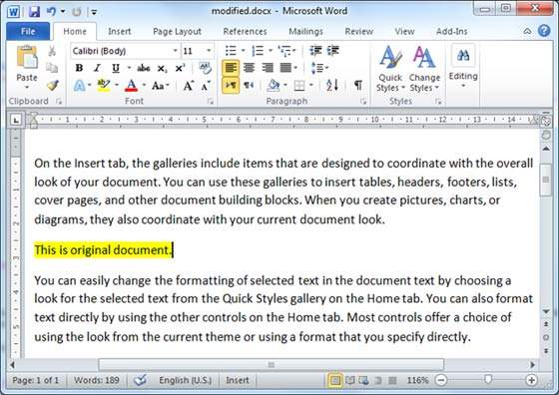
Compare Two Documents
Let us have the following two documents, (a) Original document (b) Modified version of the same document as follows.
Original Document

Slide 59
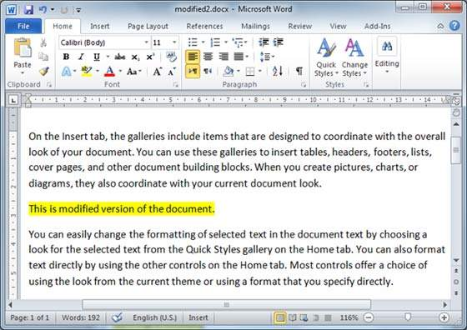
Compare Two Documents
Modified Document

Slide 60
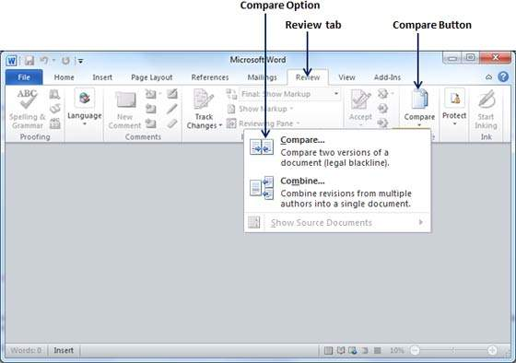
Compare Two Documents
Step 1
Click the Review tab and then click the Compare button. This will display the two options to be selected.

Slide 61
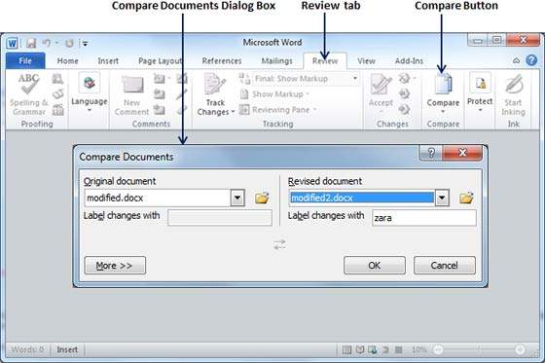
Compare Two Documents
Step 2
Select the Compare option simply by clicking over it.
This will display a Compare Documents dialog box asking for the two versions of the Word document that need to be compared with each other..

Slide 62
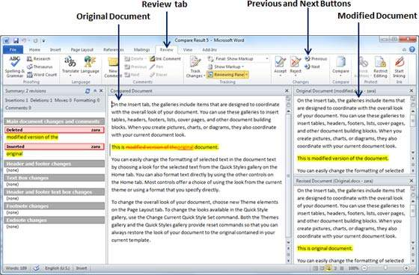
Compare Two Documents
Step 3
Select the Original Document and the Revised Document and click the OK button to display the differences in two documents.

Slide 63
Set Document Password
Step 1
Open a Word document for which you want to set a password.
Step 2
Click the File tab.
Click the Info option.
Finally click the Protect Document button which will display a list of options to be selected.

Slide 64
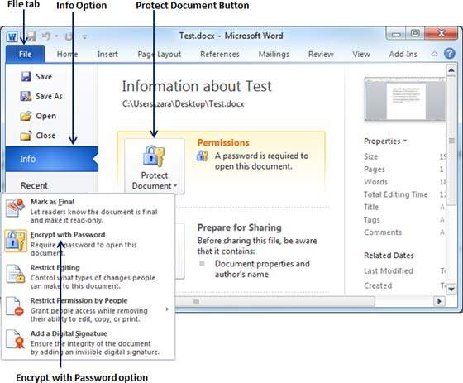
Set Document Password

Slide 65
Set Document Password
Step 3
Select the Encrypt with Password option simply by clicking over it.
This will display an Encrypt Document dialog box asking for a password to encrypt the document.
The same dialog box will appear twice to enter the same password. After entering password each time, click the OK button.

Slide 66
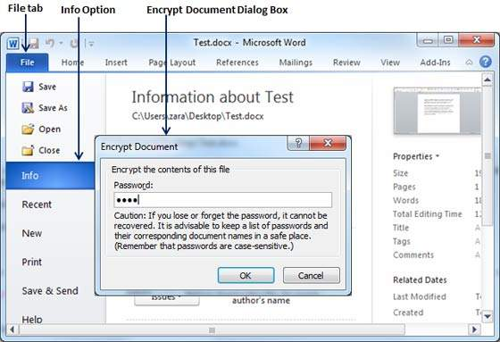
Set Document Password
Step 3

Slide 67
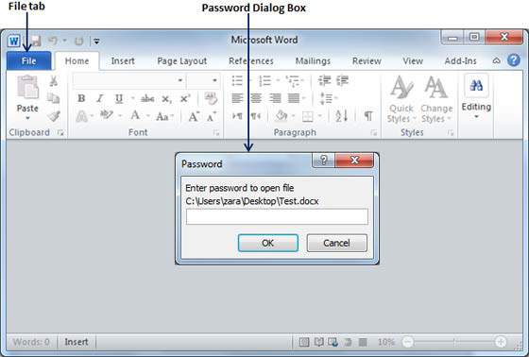
Set Document Password
Step 4
Save the changes, and finally you will have your document password protected.
Next time when someone tries to open this document, it will ask for the password before displaying the document content.

Slide 68
Remove Document Password
Step 1
Open a Word document the password of which needs to be removed. You will need the correct password to open the document.
Step 2
Click the File tab followed by the Info option and
Finally the Protect Document button which will display a list of options to be selected.

Slide 69
Remove Document Password

Slide 70
Remove Document Password
Step 3
Select the Encrypt with Password option simply by clicking over it.
This will display an Encrypt Document dialog box and password which will be in a dotted pattern.
You need to remove this dotted pattern from the box and make it clear to remove the password from the document.

Slide 71
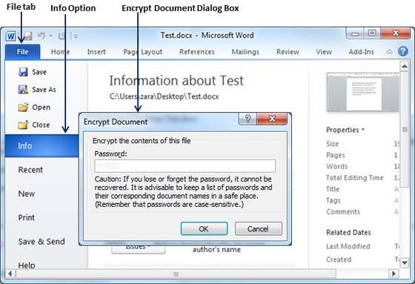
Remove Document Password
Step 3

Slide 72
Set Editing & Formatting Restrictions
Step 1
Open a Word document for which you want to set editing restrictions.
Step 2
Click the File tab and then click the Info option and
finally the Protect Document button which will display a list of options to be selected.

Slide 73
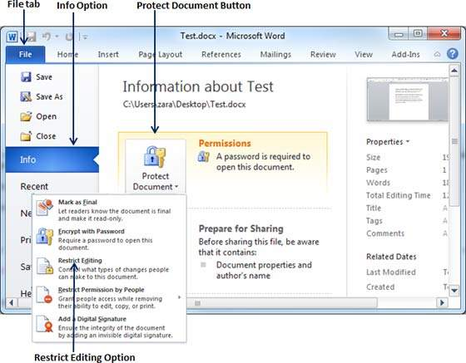
Set Editing & Formatting Restrictions

Slide 74
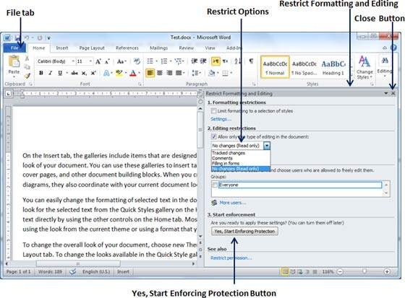
Set Editing & Formatting Restrictions
Step 3
Select the Restrict Editing option simply by clicking over it.
This will open the actual document and it will also give you the option to set editing restrictions in the Restrict Formatting and Editing area.

Slide 75
Set Editing & Formatting Restrictions
Step 4
Once you are done with your setting
click the Yes, Start Enforcing Protection button which will display a Start Enforcing Protection dialog box asking for password so that no one else can change the setting.
You can enter the password or you can leave it simply blank which means there is no password setting for this protection.

Slide 76
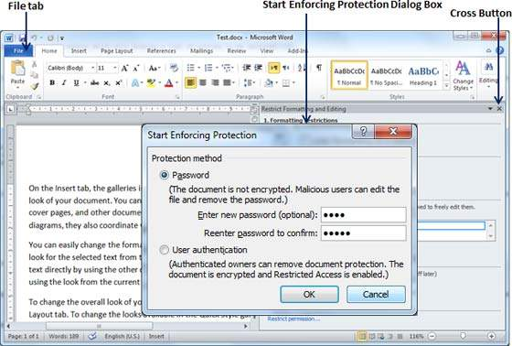
Set Editing & Formatting Restrictions
Step 5
Finally click the OK button and you will find that your document is editing (or formatting if you applied) protected.

Slide 77
Set Watermark in Word 2010
A watermark is a picture that shows up faintly behind the text on a Word document page.
When you draft a document, you can watermark the document with Draft Copy stamp, or you can watermark a duplicate document with the Duplicate stamp.
.

Slide 78
Set Standard Watermark
Step 1
Open a word document in which you want to add a watermark.
Step 2
Click the Page Layout tab and then click the Watermark button to display a list of standard watermark options.
.

Slide 79

Set Standard Watermark

Slide 80

Set Standard Watermark
Step 3
You can select any of the available standard watermarks by simply clicking over it.
This will be applied to all the pages of the word. Assume we select the Confidential watermark.

Slide 81

Set Custom Watermark
Step 1
Open a Word document in which you want to add a watermark.
Step 2
Click the Page Layout tab and then
Click the Watermark button to display a list of standard watermark options. At the bottom, you will find the Custom Watermark option.

Slide 82

Set Custom Watermark
Step 3
Click over the Custom Watermark option; this will display the Printed Watermark dialog box.

Slide 83
Set Custom Watermark
Step 4
Now you can set a picture as watermark or you can set predefined text as watermark; you can also type your text in the Text box available at Printed Watermark dialog box.
We will set text watermark as DUPLICATE and also set its font colour and font size.
Once all the parameters are set, click the OK button to set the parameters.

Slide 84

Set Custom Watermark
Step 4

Slide 85
Remove Watermark
Step 1
Open a Word document the watermark of which needs to be deleted.
Step 2
Click the Page Layout tab followed by the Watermark button to display a list of standard watermark options.
At the bottom, you will find the Remove Watermark option.
Step 3
Click Remove Watermark option; this will delete the existing watermark from the document.

Slide 86

Remove Watermark

Slide 87
Mail Merge in word 2010
Mail Merge is feature in Microsoft Word that allows the user to create multiple e-mails for different recipients at once.
Mail Merge is a feature in MS Word that takes data from a data source and inserts it into a main document containing similar information.
One specific type of information is to be addressed to different individuals with different addresses.

Slide 88
Features of Mail Merge in word 2010
Data
Data is any number or text that is to be used as information. Example: Name, address, Pin code.
Data source
It is the location where data that is used in mail merge is stored. Example a table that contains data from where data is taken and used.

Slide 89
Features of Mail Merge in word 2010
Main document
It consists of text or information that we wish to send to all the recipients. Example Letter.
Merge Field
It is data item that is to be taken from a data source and inserted into the main document. Example: Name, Address, City, etc. that is to be inserted to the main document.

Slide 90

Mail Merge in word 2010

Slide 91

Mail Merge in word 2010

Slide 92

Mail Merge in word 2010

Slide 93

Mail Merge in word 2010

Slide 94

Mail Merge in word 2010

Slide 95

Mail Merge in word 2010

Slide 96

Mail Merge in word 2010

Slide 97

Mail Merge in word 2010

Slide 98

Mail Merge in word 2010

Slide 99


Slide 100
THANK YOU

